Slide 1
Employee Data Analysis using Excel
STUDENT NAME: P. PANDI DHARANI
REGISTER NO:312209851
NM ID:E2B6D6869A979BF9D3142C0BAE475F75
DEPARTMENT: B.COM (Accounting & FINANCE)
COLLEGE : VALLIAMMAL COLLEGE FOR WOMEN

Slide 2
PROJECT TITLE
Employee Performance Analysis using Excel

Slide 3


AGENDA
Problem Statement
Project Overview
End Users
Our Solution and Proposition
Dataset Description
Modelling Approach
Results and Discussion
Conclusion
3/21/2024 Annual Review

Slide 4

PROBLEM STATEMENT Evaluate performance analysis is to calculate the performances of all departments employees identify the concern of areas which determine effectiveness

Slide 5

PROJECT OVERVIEW
.This project overview provides a clear and structured outlines of the employees performance analysis ensuring that all stakeholders understand the project purpose, scope, and expected outcomes

Slide 6

WHO ARE THE END USERS? The end users are the HR departments, head and managers, senior management and executives, employees, Board of directors.

Slide 7

OUR SOLUTION AND ITS VALUE PROPOSITION
Conditional formatting :Missing Filter : Remove
Formulas : Identify performances Pivot table : Summary Graph : Data visualization

Slide 8
Dataset Description
Employee dataset - Edunet Features -26 Features Name -First and Last Name
Start date Business unit Employment status
Employment type
Performance score Gender -Female and Male Employee rating -Number
Performance level -Numbers

Slide 9

THE "WOW" IN OUR SOLUTION Using formulas IFS(Z8>=5,”VERY HIGH”,Z8>=4,”HIGH”,Z8>=3,”MED”,TRUE,”LOW”)
3/21/2024 Annual Review
9

Slide 10
MODELLING
Data collection
Download from kaggle
Feature collection
identify the feature
Cleaning
Identify the missing values
filter out the deleted Data values
Performance level
Evaluate the performance level of an employee
Summary
pivot tables
Graph Representation
10

Slide 11
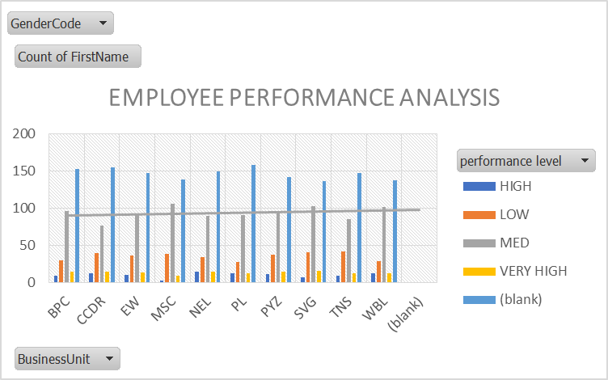
RESULTS
11

Slide 12
Conclusion The analysis shows the employee performance is consistent improving declining over the specific period. Key performance indicators such as productivity, efficiency, quality, etc…

